Slide 1
Data Mining:
Concepts and Techniques
— Slides for Textbook —
— Chapter 6 —
©Jiawei Han and Micheline Kamber
Department of Computer Science
University of Illinois at Urbana-Champaign
www.cs.uiuc.edu/~hanj

Slide 2
Chapter 6: Mining Association Rules in Large Databases
Association rule mining
Algorithms for scalable mining of (single-dimensional Boolean) association rules in transactional databases
Mining various kinds of association/correlation rules
Constraint-based association mining
Sequential pattern mining
Applications/extensions of frequent pattern mining
Summary

Slide 3
What Is Association Mining?
Association rule mining:
  Finding frequent patterns, associations, correlations, or causal structures among sets of items or objects in transaction databases, relational databases, and other information repositories.
  Frequent pattern: pattern (set of items, sequence, etc.) that occurs frequently in a database [AIS93]
Motivation: finding regularities in data
  What products were often purchased together? — Beer and diapers?!
  What are the subsequent purchases after buying a PC?
  What kinds of DNA are sensitive to this new drug?
  Can we automatically classify web documents?

Slide 4
Why Is Frequent Pattern or Assoiciation Mining an Essential Task in Data Mining?
Foundation for many essential data mining tasks
  Association, correlation, causality
  Sequential patterns, temporal or cyclic association, partial periodicity, spatial and multimedia association
  Associative classification, cluster analysis, iceberg cube, fascicles (semantic data compression)
Broad applications
  Basket data analysis, cross-marketing, catalog design, sale campaign analysis
  Web log (click stream) analysis, DNA sequence analysis, etc.

Slide 5
Basic Concepts: Frequent Patterns and Association Rules
Itemset X={x₁, …, x_{k}}
Find all the rules X→Y with min confidence and support
  support, s, probability that a transaction contains X∪Y
  confidence, c, conditional probability that a transaction having X also contains Y.
Transaction-id | Items bought
10 | A, B, C
20 | A, C
30 | A, D
40 | B, E, F
Customer
buys both
Customer
buys diaper
Let min_support = 50%, min_conf = 50%:
  A → C (50%, 66.7%)
  C → A (50%, 100%)
Customer
buys beer

Slide 6
Mining Association Rules—an Example
Min. support 50%
Min. confidence 50%
Transaction-id | Items bought
10 | A, B, C
20 | A, C
30 | A, D
40 | B, E, F
Frequent pattern | Support
{A} | 75%
{B} | 50%
{C} | 50%
{A, C} | 50%
For rule A ⇒ C:
  support = support({A}∪{C}) = 50%
  confidence = support({A}∪{C})/support({A}) = 66.6%

Slide 7
Chapter 6: Mining Association Rules in Large Databases
Association rule mining
Algorithms for scalable mining of (single-dimensional Boolean) association rules in transactional databases
Mining various kinds of association/correlation rules
Constraint-based association mining
Sequential pattern mining
Applications/extensions of frequent pattern mining
Summary

Slide 8
Apriori: A Candidate Generation-and-test Approach
Any subset of a frequent itemset must be frequent
  if {beer, diaper, nuts} is frequent, so is {beer, diaper}
  Every transaction having {beer, diaper, nuts} also contains {beer, diaper}
Apriori pruning principle: If there is any itemset which is infrequent, its superset should not be generated/tested!
Method:
  generate length (k+1) candidate itemsets from length k frequent itemsets, and
  test the candidates against DB
The performance studies show its efficiency and scalability
Agrawal & Srikant 1994, Mannila, et al. 1994

Slide 9
The Apriori Algorithm—An Example
Itemset | sup
{A} | 2
{B} | 3
{C} | 3
{D} | 1
{E} | 3
Database TDB
Itemset | sup
{A} | 2
{B} | 3
{C} | 3
{E} | 3
L₁
Tid | Items
10 | A, C, D
20 | B, C, E
30 | A, B, C, E
40 | B, E
C₁
1st scan
C₂
Itemset | sup
{A, B} | 1
{A, C} | 2
{A, E} | 1
{B, C} | 2
{B, E} | 3
{C, E} | 2
C₂
L₂
Itemset
{A, B}
{A, C}
{A, E}
{B, C}
{B, E}
{C, E}
Itemset | sup
{A, C} | 2
{B, C} | 2
{B, E} | 3
{C, E} | 2
2nd scan
C₃
Itemset
{B, C, E}
3rd scan
L₃
Itemset | sup
{B, C, E} | 2

Slide 10
The Apriori Algorithm
Pseudo-code:
    C_{k}: Candidate itemset of size k
    L_{k} : frequent itemset of size k
    L₁ = {frequent items};
    for (k = 1; L_{k} !=∅; k++) do begin
    C_{k+1} = candidates generated from L_{k};
    for each transaction t in database do
      increment the count of all candidates in C_{k+1} that are contained in t
    L_{k+1} = candidates in C_{k+1} with min_support
    end
    return ∪_{k} L_{k};

Slide 11
Important Details of Apriori
How to generate candidates?
  Step 1: self-joining L_{k}
  Step 2: pruning
How to count supports of candidates?
Example of Candidate-generation
  L₃={abc, abd, acd, ace, bcd}
  Self-joining: L₃*L₃
    abcd from abc and abd
    acde from acd and ace
  Pruning:
    acde is removed because ade is not in L₃
  C₄={abcd}

Slide 12
How to Generate Candidates?
Suppose the items in L_{k-1} are listed in an order
Step 1: self-joining L_{k-1}
  insert into C_{k}
  select p.item₁, p.item₂, …, p.item_{k-1}, q.item_{k-1}
  from L_{k-1} p, L_{k-1} q
  where p.item₁=q.item₁, …, p.item_{k-2}=q.item_{k-2}, p.item_{k-1} < q.item_{k-1}
Step 2: pruning
  forall itemsets c in C_{k} do
    forall (k-1)-subsets s of c do
      if (s is not in L_{k-1}) then delete c from C_{k}

Slide 13
How to Count Supports of Candidates?
Why counting supports of candidates a problem?
  The total number of candidates can be very huge
  One transaction may contain many candidates
Method:
  Candidate itemsets are stored in a hash-tree
  Leaf node of hash-tree contains a list of itemsets and counts
  Interior node contains a hash table
  Subset function: finds all the candidates contained in a transaction

Slide 14
Example: Counting Supports of Candidates
Subset function
Transaction: 1 2 3 5 6
3,6,9
1,4,7
2,5,8
1 + 2 3 5 6
1 3 + 5 6
2 3 4
5 6 7
1 4 5
3 4 5
3 5 6
3 5 7
6 8 9
3 6 7
3 6 8
1 3 6
1 2 + 3 5 6
1 2 4
4 5 7
1 2 5
4 5 8
1 5 9

Slide 15
Efficient Implementation of Apriori in SQL
Hard to get good performance out of pure SQL (SQL-92) based approaches alone
Make use of object-relational extensions like UDFs, BLOBs, Table functions etc.
  Get orders of magnitude improvement
S. Sarawagi, S. Thomas, and R. Agrawal. Integrating association rule mining with relational database systems: Alternatives and implications. In SIGMOD’98

Slide 16
Challenges of Frequent Pattern Mining
Challenges
  Multiple scans of transaction database
  Huge number of candidates
  Tedious workload of support counting for candidates
Improving Apriori: general ideas
  Reduce passes of transaction database scans
  Shrink number of candidates
  Facilitate support counting of candidates

Slide 17
DIC: Reduce Number of Scans
ABCD
Once both A and D are determined frequent, the counting of AD begins
Once all length-2 subsets of BCD are determined frequent, the counting of BCD begins
ABC
ABD
ACD
BCD
AB
AC
BC
AD
BD
CD
Transactions
1-itemsets
A
B
C
D
Apriori
2-itemsets
…
{}
Itemset lattice
1-itemsets
S. Brin R. Motwani, J. Ullman, and S. Tsur. Dynamic itemset counting and implication rules for market basket data. In SIGMOD’97
2-items
DIC
3-items

Slide 18
Partition: Scan Database Only Twice
Any itemset that is potentially frequent in DB must be frequent in at least one of the partitions of DB
  Scan 1: partition database and find local frequent patterns
  Scan 2: consolidate global frequent patterns
A. Savasere, E. Omiecinski, and S. Navathe. An efficient algorithm for mining association in large databases. In VLDB’95

Slide 19
Sampling for Frequent Patterns
Select a sample of original database, mine frequent patterns within sample using Apriori
Scan database once to verify frequent itemsets found in sample, only borders of closure of frequent patterns are checked
  Example: check abcd instead of ab, ac, …, etc.
Scan database again to find missed frequent patterns
H. Toivonen. Sampling large databases for association rules. In VLDB’96

Slide 20
DHP: Reduce the Number of Candidates
A k-itemset whose corresponding hashing bucket count is below the threshold cannot be frequent
  Candidates: a, b, c, d, e
  Hash entries: {ab, ad, ae} {bd, be, de} …
  Frequent 1-itemset: a, b, d, e
  ab is not a candidate 2-itemset if the sum of count of {ab, ad, ae} is below support threshold
J. Park, M. Chen, and P. Yu. An effective hash-based algorithm for mining association rules. In SIGMOD’95

Slide 21
Eclat/MaxEclat and VIPER: Exploring Vertical Data Format
Use tid-list, the list of transaction-ids containing an itemset
Compression of tid-lists
  Itemset A: t1, t2, t3, sup(A)=3
  Itemset B: t2, t3, t4, sup(B)=3
  Itemset AB: t2, t3, sup(AB)=2
Major operation: intersection of tid-lists
M. Zaki et al. New algorithms for fast discovery of association rules. In KDD’97
P. Shenoy et al. Turbo-charging vertical mining of large databases. In SIGMOD’00

Slide 22
Bottleneck of Frequent-pattern Mining
Multiple database scans are costly
Mining long patterns needs many passes of scanning and generates lots of candidates
  To find frequent itemset i₁i₂…i₁₀₀
    # of scans: 100
    # of Candidates: (₁₀₀¹) + (₁₀₀²) + … + (₁¹₀⁰₀⁰) = 2¹⁰⁰-1 = 1.27*10³⁰ !
Bottleneck: candidate-generation-and-test
Can we avoid candidate generation?

Slide 23
Mining Frequent Patterns Without Candidate Generation
Grow long patterns from short ones using local frequent items
  “abc” is a frequent pattern
  Get all transactions having “abc”: DB|abc
  “d” is a local frequent item in DB|abc → abcd is a frequent pattern

Slide 24
Construct FP-tree from a Transaction Database
TID Items bought (ordered) frequent items
100 {f, a, c, d, g, i, m, p} {f, c, a, m, p}
200 {a, b, c, f, l, m, o} {f, c, a, b, m}
300 {b, f, h, j, o, w} {f, b}
400 {b, c, k, s, p} {c, b, p}
500 {a, f, c, e, l, p, m, n} {f, c, a, m, p}
min_support = 3
{}
Header Table
Item frequency head
f 4
c 4
a 3
b 3
m 3
p 3
Scan DB once, find frequent 1-itemset (single item pattern)
Sort frequent items in frequency descending order, f-list
Scan DB again, construct FP-tree
f:4
c:1
c:3
b:1
b:1
a:3
p:1
m:2
b:1
F-list=f-c-a-b-m-p
p:2
m:1

Slide 25
Benefits of the FP-tree Structure
Completeness
  Preserve complete information for frequent pattern mining
  Never break a long pattern of any transaction
Compactness
  Reduce irrelevant info—infrequent items are gone
  Items in frequency descending order: the more frequently occurring, the more likely to be shared
  Never be larger than the original database (not count node-links and the count field)
  For Connect-4 DB, compression ratio could be over 100

Slide 26
Partition Patterns and Databases
Frequent patterns can be partitioned into subsets according to f-list
  F-list=f-c-a-b-m-p
  Patterns containing p
  Patterns having m but no p
  …
  Patterns having c but no a nor b, m, p
  Pattern f
Completeness and non-redundency

Slide 27
Find Patterns Having P From P-conditional Database
Starting at the frequent item header table in the FP-tree
Traverse the FP-tree by following the link of each frequent item p
Accumulate all of transformed prefix paths of item p to form p’s conditional pattern base
{}
Header Table
Item frequency head
f 4
c 4
a 3
b 3
m 3
p 3
f:4
c:1
Conditional pattern bases
item cond. pattern base
c f:3
a fc:3
b fca:1, f:1, c:1
m fca:2, fcab:1
p fcam:2, cb:1
c:3
b:1
b:1
a:3
p:1
m:2
b:1
p:2
m:1

Slide 28
From Conditional Pattern-bases to Conditional FP-trees
For each pattern-base
  Accumulate the count for each item in the base
  Construct the FP-tree for the frequent items of the pattern base
m-conditional pattern base:
  fca:2, fcab:1
{}
Header Table
Item frequency head
f 4
c 4
a 3
b 3
m 3
p 3
f:4
c:1
All frequent patterns relate to m
m,
fm, cm, am,
fcm, fam, cam,
fcam
{}
c:3
b:1
b:1

f:3

a:3
p:1
m:2
b:1
c:3
p:2
m:1
a:3
m-conditional FP-tree

Slide 29
Recursion: Mining Each Conditional FP-tree
{}
{}
Cond. pattern base of “am”: (fc:3)
f:3
c:3
f:3
am-conditional FP-tree
c:3
{}
Cond. pattern base of “cm”: (f:3)
a:3
f:3
m-conditional FP-tree
cm-conditional FP-tree
{}
Cond. pattern base of “cam”: (f:3)
f:3
cam-conditional FP-tree

Slide 30
A Special Case: Single Prefix Path in FP-tree
Suppose a (conditional) FP-tree T has a shared single prefix-path P
Mining can be decomposed into two parts
  Reduction of the single prefix path into one node
  Concatenation of the mining results of the two parts
{}
a₁:n₁
a₂:n₂
a₃:n₃
{}
r₁
b₁:m₁
C₁:k₁
a₁:n₁
+

r₁
=
b₁:m₁
C₁:k₁
a₂:n₂
C₂:k₂
C₃:k₃
a₃:n₃
C₂:k₂
C₃:k₃

Slide 31
Mining Frequent Patterns With FP-trees
Idea: Frequent pattern growth
  Recursively grow frequent patterns by pattern and database partition
Method
  For each frequent item, construct its conditional pattern-base, and then its conditional FP-tree
  Repeat the process on each newly created conditional FP-tree
  Until the resulting FP-tree is empty, or it contains only one path—single path will generate all the combinations of its sub-paths, each of which is a frequent pattern

Slide 32
Scaling FP-growth by DB Projection
FP-tree cannot fit in memory?—DB projection
First partition a database into a set of projected DBs
Then construct and mine FP-tree for each projected DB
Parallel projection vs. Partition projection techniques
  Parallel projection is space costly

Slide 33
Partition-based Projection
Parallel projection needs a lot of disk space
Partition projection saves it
Tran. DB
fcamp
fcabm
fb
cbp
fcamp
p-proj DB
fcam
cb
fcam
m-proj DB
fcab
fca
fca
b-proj DB
f
cb
…
a-proj DB
fc
…
c-proj DB
f
…
f-proj DB
…
am-proj DB
fc
fc
fc
cm-proj DB
f
f
f
…

Slide 34

FP-Growth vs. Apriori: Scalability With the Support Threshold
Data set T25I20D10K

Slide 35
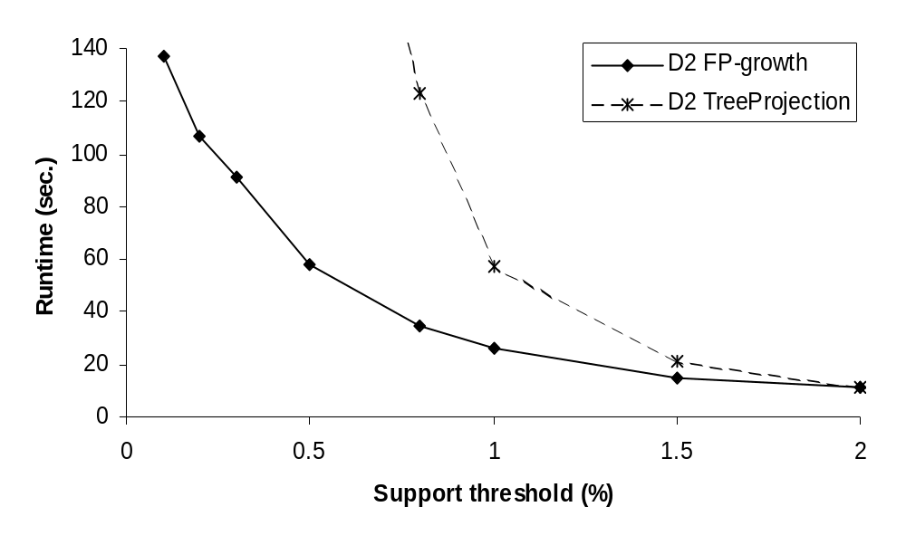
FP-Growth vs. Tree-Projection: Scalability with the Support Threshold
Data set T25I20D100K

Slide 36
Why Is FP-Growth the Winner?
Divide-and-conquer:
  decompose both the mining task and DB according to the frequent patterns obtained so far
  leads to focused search of smaller databases
Other factors
  no candidate generation, no candidate test
  compressed database: FP-tree structure
  no repeated scan of entire database
  basic ops—counting local freq items and building sub FP-tree, no pattern search and matching

Slide 37
Implications of the Methodology
Mining closed frequent itemsets and max-patterns
  CLOSET (DMKD’00)
Mining sequential patterns
  FreeSpan (KDD’00), PrefixSpan (ICDE’01)
Constraint-based mining of frequent patterns
  Convertible constraints (KDD’00, ICDE’01)
Computing iceberg data cubes with complex measures
  H-tree and H-cubing algorithm (SIGMOD’01)

Slide 38
Max-patterns
Frequent pattern {a₁, …, a₁₀₀} → (₁₀₀¹) + (₁₀₀²) + … + (₁¹₀⁰₀⁰) = 2¹⁰⁰-1 = 1.27*10³⁰ frequent sub-patterns!
Max-pattern: frequent patterns without proper frequent super pattern
  BCDE, ACD are max-patterns
  BCD is not a max-pattern
Tid | Items
10 | A,B,C,D,E
20 | B,C,D,E,
30 | A,C,D,F
Min_sup=2

Slide 39
MaxMiner: Mining Max-patterns
1st scan: find frequent items
  A, B, C, D, E
2nd scan: find support for
  AB, AC, AD, AE, ABCDE
  BC, BD, BE, BCDE
  CD, CE, CDE, DE,
Since BCDE is a max-pattern, no need to check BCD, BDE, CDE in later scan
R. Bayardo. Efficiently mining long patterns from databases. In SIGMOD’98
Tid | Items
10 | A,B,C,D,E
20 | B,C,D,E,
30 | A,C,D,F
Potential max-patterns

Slide 40
Frequent Closed Patterns
Conf(ac→d)=100% ➔ record acd only
For frequent itemset X, if there exists no item y s.t. every transaction containing X also contains y, then X is a frequent closed pattern
  “acd” is a frequent closed pattern
Concise rep. of freq pats
Reduce # of patterns and rules
N. Pasquier et al. In ICDT’99
Min_sup=2
TID | Items
10 | a, c, d, e, f
20 | a, b, e
30 | c, e, f
40 | a, c, d, f
50 | c, e, f

Slide 41
Mining Frequent Closed Patterns: CLOSET
Flist: list of all frequent items in support ascending order
  Flist: d-a-f-e-c
Divide search space
  Patterns having d
  Patterns having d but no a, etc.
Find frequent closed pattern recursively
  Every transaction having d also has cfa → cfad is a frequent closed pattern
J. Pei, J. Han & R. Mao. CLOSET: An Efficient Algorithm for Mining Frequent Closed Itemsets", DMKD'00.
Min_sup=2
TID | Items
10 | a, c, d, e, f
20 | a, b, e
30 | c, e, f
40 | a, c, d, f
50 | c, e, f

Slide 42
Mining Frequent Closed Patterns: CHARM
Use vertical data format: t(AB)={T₁, T₁₂, …}
Derive closed pattern based on vertical intersections
  t(X)=t(Y): X and Y always happen together
  t(X)⊂t(Y): transaction having X always has Y
Use diffset to accelerate mining
  Only keep track of difference of tids
  t(X)={T₁, T₂, T₃}, t(Xy )={T₁, T₃}
  Diffset(Xy, X)={T₂}
M. Zaki. CHARM: An Efficient Algorithm for Closed Association Rule Mining, CS-TR99-10, Rensselaer Polytechnic Institute
M. Zaki, Fast Vertical Mining Using Diffsets, TR01-1, Department of Computer Science, Rensselaer Polytechnic Institute

Slide 43

Visualization of Association Rules: Pane Graph

Slide 44

Visualization of Association Rules: Rule Graph

Slide 45
Chapter 6: Mining Association Rules in Large Databases
Association rule mining
Algorithms for scalable mining of (single-dimensional Boolean) association rules in transactional databases
Mining various kinds of association/correlation rules
Constraint-based association mining
Sequential pattern mining
Applications/extensions of frequent pattern mining
Summary

Slide 46
Mining Various Kinds of Rules or Regularities
Multi-level, quantitative association rules, correlation and causality, ratio rules, sequential patterns, emerging patterns, temporal associations, partial periodicity
Classification, clustering, iceberg cubes, etc.

Slide 47
Multiple-level Association Rules
Items often form hierarchy
Flexible support settings: Items at the lower level are expected to have lower support.
Transaction database can be encoded based on dimensions and levels
explore shared multi-level mining
uniform support
reduced support
Level 1
min_sup = 5%
Milk
[support = 10%]
Level 1
min_sup = 5%
Level 2
min_sup = 5%
2% Milk
[support = 6%]
Skim Milk
[support = 4%]
Level 2
min_sup = 3%

Slide 48
ML/MD Associations with Flexible Support Constraints
Why flexible support constraints?
  Real life occurrence frequencies vary greatly
    Diamond, watch, pens in a shopping basket
  Uniform support may not be an interesting model
A flexible model
  The lower-level, the more dimension combination, and the long pattern length, usually the smaller support
  General rules should be easy to specify and understand
  Special items and special group of items may be specified individually and have higher priority

Slide 49
Multi-dimensional Association
Single-dimensional rules:
    buys(X, “milk”) ⇒ buys(X, “bread”)
Multi-dimensional rules: ≥ 2 dimensions or predicates
  Inter-dimension assoc. rules (no repeated predicates)
    age(X,”19-25”) ∧ occupation(X,“student”) ⇒ buys(X,“coke”)
  hybrid-dimension assoc. rules (repeated predicates)
    age(X,”19-25”) ∧ buys(X, “popcorn”) ⇒ buys(X, “coke”)
Categorical Attributes
  finite number of possible values, no ordering among values
Quantitative Attributes
  numeric, implicit ordering among values

Slide 50
Multi-level Association: Redundancy Filtering
Some rules may be redundant due to “ancestor” relationships between items.
Example
  milk ⇒ wheat bread [support = 8%, confidence = 70%]
  2% milk ⇒ wheat bread [support = 2%, confidence = 72%]
We say the first rule is an ancestor of the second rule.
A rule is redundant if its support is close to the “expected” value, based on the rule’s ancestor.

Slide 51
Multi-Level Mining: Progressive Deepening
A top-down, progressive deepening approach:
  First mine high-level frequent items:
milk (15%), bread (10%)
  Then mine their lower-level “weaker” frequent itemsets:
2% milk (5%), wheat bread (4%)
Different min_support threshold across multi-levels lead to different algorithms:
  If adopting the same min_support across multi-levels
    then toss t if any of t’s ancestors is infrequent.
  If adopting reduced min_support at lower levels
    then examine only those descendents whose ancestor’s support is frequent/non-negligible.

Slide 52
Techniques for Mining MD Associations
Search for frequent k-predicate set:
  Example: {age, occupation, buys} is a 3-predicate set
  Techniques can be categorized by how age are treated
1. Using static discretization of quantitative attributes
  Quantitative attributes are statically discretized by using predefined concept hierarchies
2. Quantitative association rules
  Quantitative attributes are dynamically discretized into “bins”based on the distribution of the data
3. Distance-based association rules
  This is a dynamic discretization process that considers the distance between data points

Slide 53
Static Discretization of Quantitative Attributes
Discretized prior to mining using concept hierarchy.
Numeric values are replaced by ranges.
In relational database, finding all frequent k-predicate sets will require k or k+1 table scans.
Data cube is well suited for mining.
The cells of an n-dimensional
  cuboid correspond to the
  predicate sets.
Mining from data cubes
can be much faster.
()
(age)
(income)
(buys)
(age, income)
(age,buys)
(income,buys)
(age,income,buys)

Slide 54

Quantitative Association Rules
Numeric attributes are dynamically discretized
  Such that the confidence or compactness of the rules mined is maximized
2-D quantitative association rules: A_{quan1} ∧ A_{quan2} ⇒ A_{cat}
Cluster “adjacent”
  association rules
  to form general
  rules using a 2-D
  grid
Example
age(X,”30-34”) ∧ income(X,”24K - 48K”)
⇒ buys(X,”high resolution TV”)

Slide 55
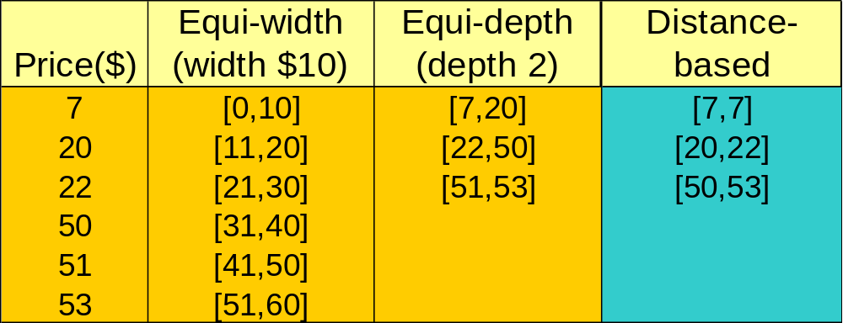
Mining Distance-based Association Rules
Binning methods do not capture the semantics of interval data
Distance-based partitioning, more meaningful discretization considering:
  density/number of points in an interval
  “closeness” of points in an interval

Slide 56
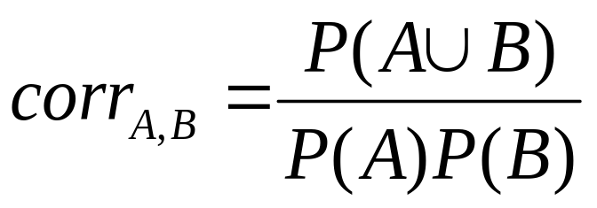
Interestingness Measure: Correlations (Lift)
play basketball ⇒ eat cereal [40%, 66.7%] is misleading
  The overall percentage of students eating cereal is 75% which is higher than 66.7%.
play basketball ⇒ not eat cereal [20%, 33.3%] is more accurate, although with lower support and confidence
Measure of dependent/correlated events: lift
 | Basketball | Not basketball | Sum (row)
Cereal | 2000 | 1750 | 3750
Not cereal | 1000 | 250 | 1250
Sum(col.) | 3000 | 2000 | 5000

Slide 57
Chapter 6: Mining Association Rules in Large Databases
Association rule mining
Algorithms for scalable mining of (single-dimensional Boolean) association rules in transactional databases
Mining various kinds of association/correlation rules
Constraint-based association mining
Sequential pattern mining
Applications/extensions of frequent pattern mining
Summary

Slide 58
Constraint-based Data Mining
Finding all the patterns in a database autonomously? — unrealistic!
  The patterns could be too many but not focused!
Data mining should be an interactive process
  User directs what to be mined using a data mining query language (or a graphical user interface)
Constraint-based mining
  User flexibility: provides constraints on what to be mined
  System optimization: explores such constraints for efficient mining—constraint-based mining

Slide 59
Constraints in Data Mining
Knowledge type constraint:
  classification, association, etc.
Data constraint — using SQL-like queries
  find product pairs sold together in stores in Vancouver in Dec.’00
Dimension/level constraint
  in relevance to region, price, brand, customer category
Rule (or pattern) constraint
  small sales (price < $10) triggers big sales (sum > $200)
Interestingness constraint
  strong rules: min_support ≥ 3%, min_confidence ≥ 60%

Slide 60
Constrained Mining vs. Constraint-Based Search
Constrained mining vs. constraint-based search/reasoning
  Both are aimed at reducing search space
  Finding all patterns satisfying constraints vs. finding some (or one) answer in constraint-based search in AI
  Constraint-pushing vs. heuristic search
  It is an interesting research problem on how to integrate them
Constrained mining vs. query processing in DBMS
  Database query processing requires to find all
  Constrained pattern mining shares a similar philosophy as pushing selections deeply in query processing

Slide 61
Constrained Frequent Pattern Mining: A Mining Query Optimization Problem
Given a frequent pattern mining query with a set of constraints C, the algorithm should be
  sound: it only finds frequent sets that satisfy the given constraints C
  complete: all frequent sets satisfying the given constraints C are found
A naïve solution
  First find all frequent sets, and then test them for constraint satisfaction
More efficient approaches:
  Analyze the properties of constraints comprehensively
  Push them as deeply as possible inside the frequent pattern computation.

Slide 62
Anti-Monotonicity in Constraint-Based Mining
TDB (min_sup=2)
Anti-monotonicity
  When an intemset S violates the constraint, so does any of its superset
  sum(S.Price) ≤ v is anti-monotone
  sum(S.Price) ≥ v is not anti-monotone
Example. C: range(S.profit) ≤ 15 is anti-monotone
  Itemset ab violates C
  So does every superset of ab
TID
Transaction
10
a, b, c, d, f
20
b, c, d, f, g, h
30
a, c, d, e, f
40
c, e, f, g
Item | Profit
a | 40
b | 0
c | -20
d | 10
e | -30
f | 30
g | 20
h | -10

Slide 63
Which Constraints Are Anti-Monotone?
Constraint | Antimonotone
v ∈ S | No
S ⊇ V | no
S ⊆ V | yes
min(S) ≤ v | no
min(S) ≥ v | yes
max(S) ≤ v | yes
max(S) ≥ v | no
count(S) ≤ v | yes
count(S) ≥ v | no
sum(S) ≤ v ( a ∈ S, a ≥ 0 ) | yes
sum(S) ≥ v ( a ∈ S, a ≥ 0 ) | no
range(S) ≤ v | yes
range(S) ≥ v | no
avg(S) θ v, θ ∈ { =, ≤, ≥ } | convertible
support(S) ≥ ξ | yes
support(S) ≤ ξ | no

Slide 64
Monotonicity in Constraint-Based Mining
TDB (min_sup=2)
Monotonicity
  When an intemset S satisfies the constraint, so does any of its superset
  sum(S.Price) ≥ v is monotone
  min(S.Price) ≤ v is monotone
Example. C: range(S.profit) ≥ 15
  Itemset ab satisfies C
  So does every superset of ab
TID
Transaction
10
a, b, c, d, f
20
b, c, d, f, g, h
30
a, c, d, e, f
40
c, e, f, g
Item | Profit
a | 40
b | 0
c | -20
d | 10
e | -30
f | 30
g | 20
h | -10

Slide 65
Which Constraints Are Monotone?
Constraint | Monotone
v ∈ S | yes
S ⊇ V | yes
S ⊆ V | no
min(S) ≤ v | yes
min(S) ≥ v | no
max(S) ≤ v | no
max(S) ≥ v | yes
count(S) ≤ v | no
count(S) ≥ v | yes
sum(S) ≤ v ( a ∈ S, a ≥ 0 ) | no
sum(S) ≥ v ( a ∈ S, a ≥ 0 ) | yes
range(S) ≤ v | no
range(S) ≥ v | yes
avg(S) θ v, θ ∈ { =, ≤, ≥ } | convertible
support(S) ≥ ξ | no
support(S) ≤ ξ | yes

Slide 66
Succinctness
Succinctness:
  Given A_{1,} the set of items satisfying a succinctness constraint C, then any set S satisfying C is based on A₁ , i.e., S contains a subset belonging to A₁
  Idea: Without looking at the transaction database, whether an itemset S satisfies constraint C can be determined based on the selection of items
  min(S.Price) ≤ v is succinct
  sum(S.Price) ≥ v is not succinct
Optimization: If C is succinct, C is pre-counting pushable

Slide 67
Which Constraints Are Succinct?
Constraint | Succinct
v ∈ S | yes
S ⊇ V | yes
S ⊆ V | yes
min(S) ≤ v | yes
min(S) ≥ v | yes
max(S) ≤ v | yes
max(S) ≥ v | yes
count(S) ≤ v | weakly
count(S) ≥ v | weakly
sum(S) ≤ v ( a ∈ S, a ≥ 0 ) | no
sum(S) ≥ v ( a ∈ S, a ≥ 0 ) | no
range(S) ≤ v | no
range(S) ≥ v | no
avg(S) θ v, θ ∈ { =, ≤, ≥ } | no
support(S) ≥ ξ | no
support(S) ≤ ξ | no

Slide 68








The Apriori Algorithm — Example
Database D
L₁
C₁
Scan D
C₂
C₂
L₂
Scan D
C₃
Scan D
L₃

Slide 69
Naïve Algorithm: Apriori + Constraint
Database D
L₁
C₁
Scan D
C₂
C₂
L₂
Scan D
C₃
Scan D
L₃
Constraint:
Sum{S.price < 5}

Slide 70
The Constrained Apriori Algorithm: Push an Anti-monotone Constraint Deep
Database D
L₁
C₁
Scan D
C₂
C₂
L₂
Scan D
C₃
Scan D
L₃
Constraint:
Sum{S.price < 5}

Slide 71
The Constrained Apriori Algorithm: Push a Succinct Constraint Deep
Database D
L₁
C₁
Scan D
C₂
C₂
L₂
Scan D
C₃
Scan D
L₃
Constraint:
min{S.price <= 1 }

Slide 72
Converting “Tough” Constraints
TDB (min_sup=2)
TID
Transaction
Convert tough constraints into anti-monotone or monotone by properly ordering items
Examine C: avg(S.profit) ≥ 25
  Order items in value-descending order
    <a, f, g, d, b, h, c, e>
  If an itemset afb violates C
    So does afbh, afb*
    It becomes anti-monotone!
10
a, b, c, d, f
20
b, c, d, f, g, h
30
a, c, d, e, f
40
c, e, f, g
Item | Profit
a | 40
b | 0
c | -20
d | 10
e | -30
f | 30
g | 20
h | -10

Slide 73
Convertible Constraints
Let R be an order of items
Convertible anti-monotone
  If an itemset S violates a constraint C, so does every itemset having S as a prefix w.r.t. R
  Ex. avg(S) ≤ v w.r.t. item value descending order
Convertible monotone
  If an itemset S satisfies constraint C, so does every itemset having S as a prefix w.r.t. R
  Ex. avg(S) ≥ v w.r.t. item value descending order

Slide 74
Strongly Convertible Constraints
avg(X) ≥ 25 is convertible anti-monotone w.r.t. item value descending order R: <a, f, g, d, b, h, c, e>
  If an itemset af violates a constraint C, so does every itemset with af as prefix, such as afd
avg(X) ≥ 25 is convertible monotone w.r.t. item value ascending order R⁻¹: <e, c, h, b, d, g, f, a>
  If an itemset d satisfies a constraint C, so does itemsets df and dfa, which having d as a prefix
Thus, avg(X) ≥ 25 is strongly convertible
Item | Profit
a | 40
b | 0
c | -20
d | 10
e | -30
f | 30
g | 20
h | -10

Slide 75
What Constraints Are Convertible?
Constraint | Convertible anti-monotone | Convertible monotone | Strongly convertible
avg(S) ≤ , ≥ v | Yes | Yes | Yes
median(S) ≤ , ≥ v | Yes | Yes | Yes
sum(S) ≤ v (items could be of any value, v ≥ 0) | Yes | No | No
sum(S) ≤ v (items could be of any value, v ≤ 0) | No | Yes | No
sum(S) ≥ v (items could be of any value, v ≥ 0) | No | Yes | No
sum(S) ≥ v (items could be of any value, v ≤ 0) | Yes | No | No
……

Slide 76
Combing Them Together—A General Picture
Constraint | Antimonotone | Monotone | Succinct
v ∈ S | no | yes | yes
S ⊇ V | no | yes | yes
S ⊆ V | yes | no | yes
min(S) ≤ v | no | yes | yes
min(S) ≥ v | yes | no | yes
max(S) ≤ v | yes | no | yes
max(S) ≥ v | no | yes | yes
count(S) ≤ v | yes | no | weakly
count(S) ≥ v | no | yes | weakly
sum(S) ≤ v ( a ∈ S, a ≥ 0 ) | yes | no | no
sum(S) ≥ v ( a ∈ S, a ≥ 0 ) | no | yes | no
range(S) ≤ v | yes | no | no
range(S) ≥ v | no | yes | no
avg(S) θ v, θ ∈ { =, ≤, ≥ } | convertible | convertible | no
support(S) ≥ ξ | yes | no | no
support(S) ≤ ξ | no | yes | no

Slide 77
Classification of Constraints
Monotone
Antimonotone
Strongly
convertible
Succinct
Convertible
anti-monotone
Convertible
monotone
Inconvertible

Slide 78
Mining With Convertible Constraints
TDB (min_sup=2)
TID
Transaction
C: avg(S.profit) ≥ 25
List of items in every transaction in value descending order R:
  <a, f, g, d, b, h, c, e>
  C is convertible anti-monotone w.r.t. R
Scan transaction DB once
  remove infrequent items
    Item h in transaction 40 is dropped
  Itemsets a and f are good
10
a, f, d, b, c
20
f, g, d, b, c
30
a, f, d, c, e
40
f, g, h, c, e
Item | Profit
a | 40
f | 30
g | 20
d | 10
b | 0
h | -10
c | -20
e | -30

Slide 79
Can Apriori Handle Convertible Constraint?
A convertible, not monotone nor anti-monotone nor succinct constraint cannot be pushed deep into the an Apriori mining algorithm
  Within the level wise framework, no direct pruning based on the constraint can be made
  Itemset df violates constraint C: avg(X)>=25
  Since adf satisfies C, Apriori needs df to assemble adf, df cannot be pruned
But it can be pushed into frequent-pattern growth framework!
Item | Value
a | 40
b | 0
c | -20
d | 10
e | -30
f | 30
g | 20
h | -10

Slide 80
Mining With Convertible Constraints
Item | Value
a | 40
f | 30
g | 20
d | 10
b | 0
h | -10
c | -20
e | -30
C: avg(X)>=25, min_sup=2
List items in every transaction in value descending order R: <a, f, g, d, b, h, c, e>
  C is convertible anti-monotone w.r.t. R
Scan TDB once
  remove infrequent items
    Item h is dropped
  Itemsets a and f are good, …
Projection-based mining
  Imposing an appropriate order on item projection
  Many tough constraints can be converted into (anti)-monotone
TDB (min_sup=2)
TID
Transaction
10
a, f, d, b, c
20
f, g, d, b, c
30
a, f, d, c, e
40
f, g, h, c, e

Slide 81
Handling Multiple Constraints
Different constraints may require different or even conflicting item-ordering
If there exists an order R s.t. both C₁ and C₂ are convertible w.r.t. R, then there is no conflict between the two convertible constraints
If there exists conflict on order of items
  Try to satisfy one constraint first
  Then using the order for the other constraint to mine frequent itemsets in the corresponding projected database

Slide 82
Chapter 6: Mining Association Rules in Large Databases
Association rule mining
Algorithms for scalable mining of (single-dimensional Boolean) association rules in transactional databases
Mining various kinds of association/correlation rules
Constraint-based association mining
Sequential pattern mining
Applications/extensions of frequent pattern mining
Summary

Slide 83
Sequence Databases and Sequential Pattern Analysis
Transaction databases, time-series databases vs. sequence databases
Frequent patterns vs. (frequent) sequential patterns
Applications of sequential pattern mining
  Customer shopping sequences:
    First buy computer, then CD-ROM, and then digital camera, within 3 months.
  Medical treatment, natural disasters (e.g., earthquakes), science & engineering processes, stocks and markets, etc.
  Telephone calling patterns, Weblog click streams
  DNA sequences and gene structures

Slide 84
What Is Sequential Pattern Mining?
Given a set of sequences, find the complete set of frequent subsequences
A sequence : < (ef) (ab) (df) c b >
A sequence database
SID | sequence
10 | <a(abc)(ac)d(cf)>
20 | <(ad)c(bc)(ae)>
30 | <(ef)(ab)(df)cb>
40 | <eg(af)cbc>
An element may contain a set of items.
Items within an element are unordered
and we list them alphabetically.
<a(bc)dc> is a subsequence of <a(abc)(ac)d(cf)>
Given support threshold min_sup =2, <(ab)c> is a sequential pattern

Slide 85
Challenges on Sequential Pattern Mining
A huge number of possible sequential patterns are hidden in databases
A mining algorithm should
  find the complete set of patterns, when possible, satisfying the minimum support (frequency) threshold
  be highly efficient, scalable, involving only a small number of database scans
  be able to incorporate various kinds of user-specific constraints

Slide 86
Studies on Sequential Pattern Mining
Concept introduction and an initial Apriori-like algorithm
  R. Agrawal & R. Srikant. “Mining sequential patterns,” ICDE’95
GSP—An Apriori-based, influential mining method (developed at IBM Almaden)
  R. Srikant & R. Agrawal. “Mining sequential patterns: Generalizations and performance improvements,” EDBT’96
From sequential patterns to episodes (Apriori-like + constraints)
  H. Mannila, H. Toivonen & A.I. Verkamo. “Discovery of frequent episodes in event sequences,” Data Mining and Knowledge Discovery, 1997
Mining sequential patterns with constraints
  M.N. Garofalakis, R. Rastogi, K. Shim: SPIRIT: Sequential Pattern Mining with Regular Expression Constraints. VLDB 1999

Slide 87
A Basic Property of Sequential Patterns: Apriori
A basic property: Apriori (Agrawal & Sirkant’94)
  If a sequence S is not frequent
  Then none of the super-sequences of S is frequent
  E.g, <hb> is infrequent → so do <hab> and <(ah)b>
Seq. ID
Sequence
Given support threshold min_sup =2
10
<(bd)cb(ac)>
20
<(bf)(ce)b(fg)>
30
<(ah)(bf)abf>
40
<(be)(ce)d>
50
<a(bd)bcb(ade)>

Slide 88
GSP—A Generalized Sequential Pattern Mining Algorithm
GSP (Generalized Sequential Pattern) mining algorithm
  proposed by Agrawal and Srikant, EDBT’96
Outline of the method
  Initially, every item in DB is a candidate of length-1
  for each level (i.e., sequences of length-k) do
    scan database to collect support count for each candidate sequence
    generate candidate length-(k+1) sequences from length-k frequent sequences using Apriori
  repeat until no frequent sequence or no candidate can be found
Major strength: Candidate pruning by Apriori

Slide 89
Finding Length-1 Sequential Patterns
Examine GSP using an example
Initial candidates: all singleton sequences
  <a>, <b>, <c>, <d>, <e>, <f>, <g>, <h>
Scan database once, count support for candidates
Cand | Sup
<a> | 3
<b> | 5
<c> | 4
<d> | 3
<e> | 3
<f> | 2
<g> | 1
<h> | 1
min_sup =2
Seq. ID
Sequence
10
<(bd)cb(ac)>
20
<(bf)(ce)b(fg)>
30
<(ah)(bf)abf>
40
<(be)(ce)d>
50
<a(bd)bcb(ade)>

Slide 90
Generating Length-2 Candidates
 | <a> | <b> | <c> | <d> | <e> | <f>
<a> | <aa> | <ab> | <ac> | <ad> | <ae> | <af>
<b> | <ba> | <bb> | <bc> | <bd> | <be> | <bf>
<c> | <ca> | <cb> | <cc> | <cd> | <ce> | <cf>
<d> | <da> | <db> | <dc> | <dd> | <de> | <df>
<e> | <ea> | <eb> | <ec> | <ed> | <ee> | <ef>
<f> | <fa> | <fb> | <fc> | <fd> | <fe> | <ff>
51 length-2
Candidates
 | <a> | <b> | <c> | <d> | <e> | <f>
<a> |  | <(ab)> | <(ac)> | <(ad)> | <(ae)> | <(af)>
<b> |  |  | <(bc)> | <(bd)> | <(be)> | <(bf)>
<c> |  |  |  | <(cd)> | <(ce)> | <(cf)>
<d> |  |  |  |  | <(de)> | <(df)>
<e> |  |  |  |  |  | <(ef)>
<f>
Without Apriori property,
8*8+8*7/2=92 candidates
Apriori prunes
44.57% candidates

Slide 91
Finding Length-2 Sequential Patterns
Scan database one more time, collect support count for each length-2 candidate
There are 19 length-2 candidates which pass the minimum support threshold
  They are length-2 sequential patterns

Slide 92
Generating Length-3 Candidates and Finding Length-3 Patterns
Generate Length-3 Candidates
  Self-join length-2 sequential patterns
    Based on the Apriori property
    <ab>, <aa> and <ba> are all length-2 sequential patterns → <aba> is a length-3 candidate
    <(bd)>, <bb> and <db> are all length-2 sequential patterns → <(bd)b> is a length-3 candidate
  46 candidates are generated
Find Length-3 Sequential Patterns
  Scan database once more, collect support counts for candidates
  19 out of 46 candidates pass support threshold

Slide 93
The GSP Mining Process
5th scan: 1 cand. 1 length-5 seq. pat.
<(bd)cba>
Cand. cannot pass sup. threshold
4th scan: 8 cand. 6 length-4 seq. pat.
<abba> <(bd)bc> …
Cand. not in DB at all
3rd scan: 46 cand. 19 length-3 seq. pat. 20 cand. not in DB at all
<abb> <aab> <aba> <baa> <bab> …
2nd scan: 51 cand. 19 length-2 seq. pat. 10 cand. not in DB at all
<aa> <ab> … <af> <ba> <bb> … <ff> <(ab)> … <(ef)>
1st scan: 8 cand. 6 length-1 seq. pat.
<a> <b> <c> <d> <e> <f> <g> <h>
Seq. ID
Sequence
min_sup =2
10
<(bd)cb(ac)>
20
<(bf)(ce)b(fg)>
30
<(ah)(bf)abf>
40
<(be)(ce)d>
50
<a(bd)bcb(ade)>

Slide 94
The GSP Algorithm
Take sequences in form of <x> as length-1 candidates
Scan database once, find F₁, the set of length-1 sequential patterns
Let k=1; while F_{k} is not empty do
  Form C_{k+1}, the set of length-(k+1) candidates from F_{k};
  If C_{k+1} is not empty, scan database once, find F_{k+1}, the set of length-(k+1) sequential patterns
  Let k=k+1;

Slide 95
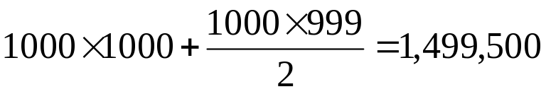
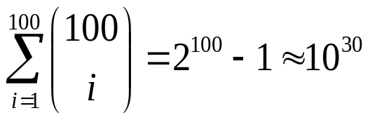
Bottlenecks of GSP
A huge set of candidates could be generated
  1,000 frequent length-1 sequences generate length-2 candidates!
Multiple scans of database in mining
Real challenge: mining long sequential patterns
  An exponential number of short candidates
  A length-100 sequential pattern needs 10³⁰ candidate sequences!

Slide 96
FreeSpan: Frequent Pattern-Projected Sequential Pattern Mining
A divide-and-conquer approach
  Recursively project a sequence database into a set of smaller databases based on the current set of frequent patterns
  Mine each projected database to find its patterns
J. Han J. Pei, B. Mortazavi-Asi, Q. Chen, U. Dayal, M.C. Hsu, FreeSpan: Frequent pattern-projected sequential pattern mining. In KDD’00.
f_list: b:5, c:4, a:3, d:3, e:3, f:2
Sequence Database SDB
< (bd) c b (ac) >
< (bf) (ce) b (fg) >
< (ah) (bf) a b f >
< (be) (ce) d >
< a (bd) b c b (ade) >
All seq. pat. can be divided into 6 subsets:
Seq. pat. containing item f
Those containing e but no f
Those containing d but no e nor f
Those containing a but no d, e or f
Those containing c but no a, d, e or f
Those containing only item b

Slide 97
From FreeSpan to PrefixSpan: Why?
Freespan:
  Projection-based: No candidate sequence needs to be generated
  But, projection can be performed at any point in the sequence, and the projected sequences do will not shrink much
PrefixSpan
  Projection-based
  But only prefix-based projection: less projections and quickly shrinking sequences

Slide 98
Prefix and Suffix (Projection)
<a>, <aa>, <a(ab)> and <a(abc)> are prefixes of sequence <a(abc)(ac)d(cf)>
Given sequence <a(abc)(ac)d(cf)>
Prefix | Suffix (Prefix-Based Projection)
<a> | <(abc)(ac)d(cf)>
<aa> | <(_bc)(ac)d(cf)>
<ab> | <(_c)(ac)d(cf)>

Slide 99
Mining Sequential Patterns by Prefix Projections
Step 1: find length-1 sequential patterns
  <a>, <b>, <c>, <d>, <e>, <f>
Step 2: divide search space. The complete set of seq. pat. can be partitioned into 6 subsets:
  The ones having prefix <a>;
  The ones having prefix <b>;
  …
  The ones having prefix <f>
SID | sequence
10 | <a(abc)(ac)d(cf)>
20 | <(ad)c(bc)(ae)>
30 | <(ef)(ab)(df)cb>
40 | <eg(af)cbc>

Slide 100
Finding Seq. Patterns with Prefix <a>
Only need to consider projections w.r.t. <a>
  <a>-projected database: <(abc)(ac)d(cf)>, <(_d)c(bc)(ae)>, <(_b)(df)cb>, <(_f)cbc>
Find all the length-2 seq. pat. Having prefix <a>: <aa>, <ab>, <(ab)>, <ac>, <ad>, <af>
  Further partition into 6 subsets
    Having prefix <aa>;
    …
    Having prefix <af>
SID | sequence
10 | <a(abc)(ac)d(cf)>
20 | <(ad)c(bc)(ae)>
30 | <(ef)(ab)(df)cb>
40 | <eg(af)cbc>

Slide 101
Completeness of PrefixSpan
SDB
SID | sequence
10 | <a(abc)(ac)d(cf)>
20 | <(ad)c(bc)(ae)>
30 | <(ef)(ab)(df)cb>
40 | <eg(af)cbc>
Length-1 sequential patterns
<a>, <b>, <c>, <d>, <e>, <f>
Having prefix <a>
Having prefix <c>, …, <f>
Having prefix <b>
<a>-projected database
<(abc)(ac)d(cf)>
<(_d)c(bc)(ae)>
<(_b)(df)cb>
<(_f)cbc>
<b>-projected database
…
Length-2 sequential
patterns
<aa>, <ab>, <(ab)>,
<ac>, <ad>, <af>
… …
Having prefix <aa>
Having prefix <af>
<aa>-proj. db
…
<af>-proj. db

Slide 102
Efficiency of PrefixSpan
No candidate sequence needs to be generated
Projected databases keep shrinking
Major cost of PrefixSpan: constructing projected databases
  Can be improved by bi-level projections

Slide 103
Optimization Techniques in PrefixSpan
Physical projection vs. pseudo-projection
  Pseudo-projection may reduce the effort of projection when the projected database fits in main memory
Parallel projection vs. partition projection
  Partition projection may avoid the blowup of disk space

Slide 104
Speed-up by Pseudo-projection
Major cost of PrefixSpan: projection
  Postfixes of sequences often appear repeatedly in recursive projected databases
When (projected) database can be held in main memory, use pointers to form projections
  Pointer to the sequence
  Offset of the postfix
s=<a(abc)(ac)d(cf)>
<a>
s|<a>: ( , 2)
<(abc)(ac)d(cf)>
<ab>
s|<ab>: ( , 4)
<(_c)(ac)d(cf)>

Slide 105
Pseudo-Projection vs. Physical Projection
Pseudo-projection avoids physically copying postfixes
  Efficient in running time and space when database can be held in main memory
However, it is not efficient when database cannot fit in main memory
  Disk-based random accessing is very costly
Suggested Approach:
  Integration of physical and pseudo-projection
  Swapping to pseudo-projection when the data set fits in memory

Slide 106
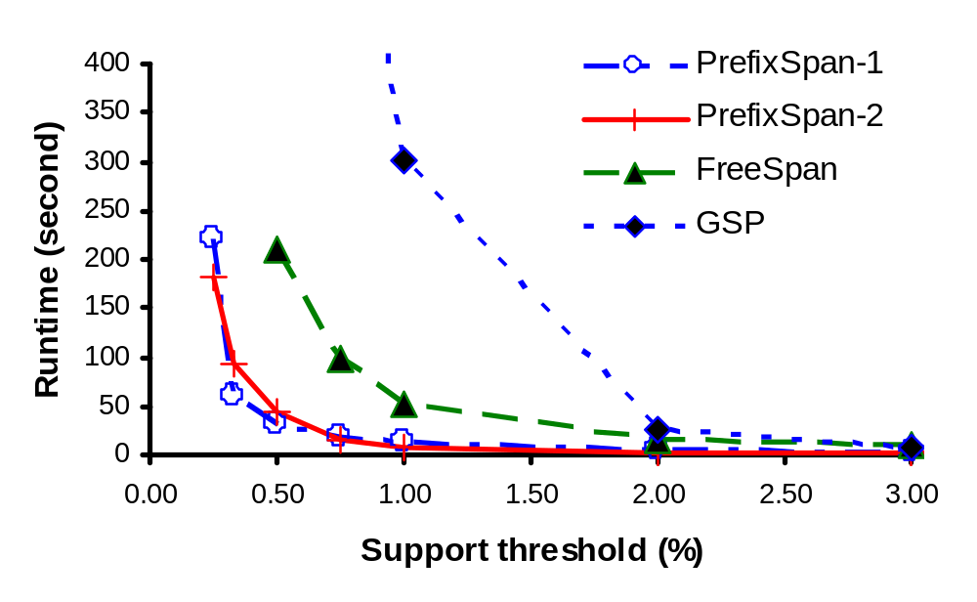
PrefixSpan Is Faster than GSP and FreeSpan

Slide 107
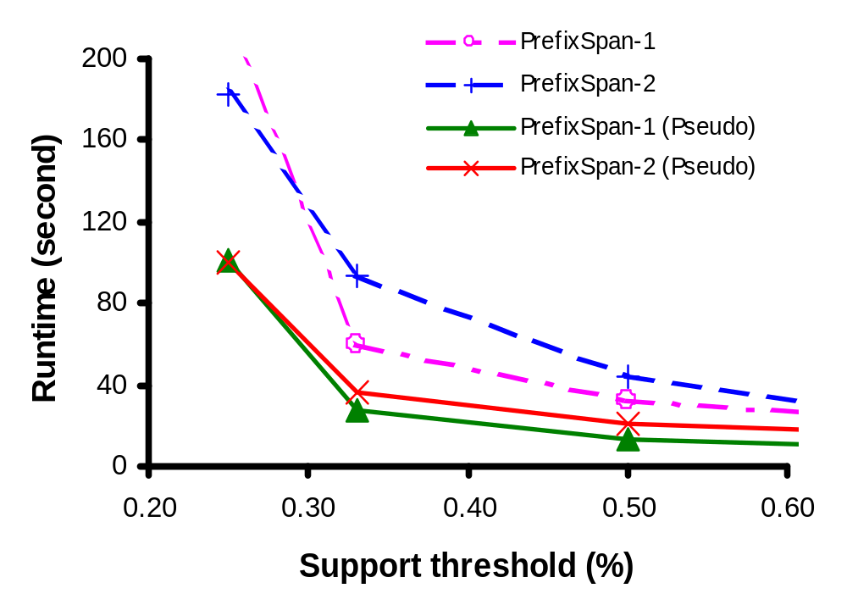
Effect of Pseudo-Projection

Slide 108
Chapter 6: Mining Association Rules in Large Databases
Association rule mining
Algorithms for scalable mining of (single-dimensional Boolean) association rules in transactional databases
Mining various kinds of association/correlation rules
Constraint-based association mining
Sequential pattern mining
Applications/extensions of frequent pattern mining
Summary

Slide 109
Associative Classification
Mine association possible rules (PR) in form of condset ➔ c
  Condset: a set of attribute-value pairs
  C: class label
Build Classifier
  Organize rules according to decreasing precedence based on confidence and support
B. Liu, W. Hsu & Y. Ma. Integrating classification and association rule mining. In KDD’98

Slide 110
Why Iceberg Cube?
It is too costly to materialize a high dimen. cube
  20 dimensions each with 99 distinct values may lead to a cube of 100²⁰ cells.
  Even if there is only one nonempty cell in each 10¹⁰ cells, the cube will still contain 10³⁰ nonempty cells
Observation: Trivial cells are usually not interesting
  Nontrivial: large volume of sales, or high profit
Solution:
  iceberg cube—materialize only nontrivial cells of a data cube

Slide 111
Anti-Monotonicity in Iceberg Cubes
If a cell c violates the HAVING clause, so do all more specific cells
Example. Let Having COUNT(*)>=50
  (*, *, Edu, 1000, 30) violates the HAVING clause
    (Feb, *, Edu), (*, Van, Edu), (Mar, Tor, Edu): each must have count no more than 30
CREATE CUBE Sales_Iceberg AS
SELECT month, city, cust_grp,
AVG(price), COUNT(*)
FROM Sales_Infor
CUBEBY month, city, cust_grp
HAVING COUNT(*)>=50
Month | City | Cust_grp | Prod | Cost | Price
Jan | Tor | Edu | Printer | 500 | 485
Mar | Van | Edu | HD | 540 | 520
… | … | … | … | … | …

Slide 112
Computing Iceberg Cubes Efficiently
Based on Apriori-like pruning
BUC [Bayer & Ramakrishnan, 99]
  bottom-up cubing, efficient bucket-sort alg.
  Only handles anti-monotonic iceberg cubes, e.g., measures confined to count and p+_sum (e.g., price)
Computing non-anti-monotonic iceberg cubes
  Finding a weaker but anti-monotonic measure (e.g., avg to top-k-avg) for dynamic pruning in computation
  Use special data structure (H-tree) and perform H-cubing (SIGMOD’01)

Slide 113
Spatial and Multi-Media Association: A Progressive Refinement Method
Why progressive refinement?
  Mining operator can be expensive or cheap, fine or rough
  Trade speed with quality: step-by-step refinement.
Superset coverage property:
  Preserve all the positive answers—allow a positive false test but not a false negative test.
Two- or multi-step mining:
  First apply rough/cheap operator (superset coverage)
  Then apply expensive algorithm on a substantially reduced candidate set (Koperski & Han, SSD’95).

Slide 114
Progressive Refinement Mining of Spatial Associations
Hierarchy of spatial relationship:
  “g_close_to”: near_by, touch, intersect, contain, etc.
  First search for rough relationship and then refine it.
Two-step mining of spatial association:
  Step 1: rough spatial computation (as a filter)
    Using MBR or R-tree for rough estimation.
  Step2: Detailed spatial algorithm (as refinement)
    Apply only to those objects which have passed the rough spatial association test (no less than min_support)

Slide 115
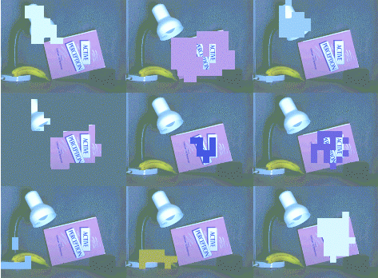

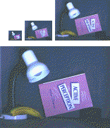
Mining Multimedia Associations
Correlations with color, spatial relationships, etc.
From coarse to Fine Resolution mining

Slide 116
Further Evolution of PrefixSpan
Closed- and max- sequential patterns
  Finding only the most meaningful (longest) sequential patterns
Constraint-based sequential pattern growth
  Adding user-specific constraints
From sequential patterns to structured patterns
  Beyond sequential patterns, mining structured patterns in XML documents

Slide 117
Closed- and Max- Sequential Patterns
A closed- sequential pattern is a frequent sequence s where there is no proper super-sequence of s sharing the same support count with s
A max- sequential pattern is a sequential pattern p s.t. any proper super-pattern of p is not frequent
Benefit of the notion of closed sequential patterns
  {<a₁ a₂ … a₅₀>, <a₁ a₂ … a₁₀₀>}, with min_sup = 1
  There are 2¹⁰⁰ sequential patterns, but only 2 are closed
Similar benefits for the notion of max- sequential-patterns

Slide 118
Methods for Mining Closed- and Max- Sequential Patterns
PrefixSpan or FreeSpan can be viewed as projection-guided depth-first search
For mining max- sequential patterns, any sequence which does not contain anything beyond the already discovered ones will be removed from the projected DB
  {<a₁ a₂ … a₅₀>, <a₁ a₂ … a₁₀₀>}, with min_sup = 1
  If we have found a max-sequential pattern <a₁ a₂ … a₁₀₀>, nothing will be projected in any projected DB
Similar ideas can be applied for mining closed- sequential-patterns

Slide 119
Constraint-Based Sequential Pattern Mining
Constraint-based sequential pattern mining
  Constraints: User-specified, for focused mining of desired patterns
  How to explore efficient mining with constraints? — Optimization
Classification of constraints
  Anti-monotone: E.g., value_sum(S) < 150, min(S) > 10
  Monotone: E.g., count (S) > 5, S ⊇ {PC, digital_camera}
  Succinct: E.g., length(S) ≥ 10, S  {Pentium, MS/Office, MS/Money}
  Convertible: E.g., value_avg(S) < 25, profit_sum (S) > 160, max(S)/avg(S) < 2, median(S) – min(S) > 5
  Inconvertible: E.g., avg(S) – median(S) = 0

Slide 120
Sequential Pattern Growth for Constraint-Based Mining
Efficient mining with convertible constraints
  Not solvable by candidate generation-and-test methodology
  Easily push-able into the sequential pattern growth framework
Example: push avg(S) < 25 in frequent pattern growth
  project items in value (price/profit depending on mining semantics) ascending/descending order for sequential pattern growth
  Grow each pattern by sequential pattern growth
  If avg(current_pattern)  25, toss the current_pattern
    Why?—future growths always make it bigger
    But why not candidate generation?—no structure or ordering in growth

Slide 121
From Sequential Patterns to Structured Patterns
Sets, sequences, trees and other structures
  Transaction DB: Sets of items
    {{i₁, i₂, …, i_{m}}, …}
  Seq. DB: Sequences of sets:
    {<{i₁, i₂}, …, {i_{m}, i_{n}, i_{k}}>, …}
  Sets of Sequences:
    {{<i₁, i₂>, …, <i_{m}, i_{n}, i_{k}>}, …}
  Sets of trees (each element being a tree):
    {t₁, t₂, …, t_{n}}
Applications: Mining structured patterns in XML documents

Slide 122
Chapter 6: Mining Association Rules in Large Databases
Association rule mining
Algorithms for scalable mining of (single-dimensional Boolean) association rules in transactional databases
Mining various kinds of association/correlation rules
Constraint-based association mining
Sequential pattern mining
Applications/extensions of frequent pattern mining
Summary

Slide 123
Frequent-Pattern Mining: Achievements
Frequent pattern mining—an important task in data mining
Frequent pattern mining methodology
  Candidate generation & test vs. projection-based (frequent-pattern growth)
  Vertical vs. horizontal format
  Various optimization methods: database partition, scan reduction, hash tree, sampling, border computation, clustering, etc.
Related frequent-pattern mining algorithm: scope extension
  Mining closed frequent itemsets and max-patterns (e.g., MaxMiner, CLOSET, CHARM, etc.)
  Mining multi-level, multi-dimensional frequent patterns with flexible support constraints
  Constraint pushing for mining optimization
  From frequent patterns to correlation and causality

Slide 124
Frequent-Pattern Mining: Applications
Related problems which need frequent pattern mining
  Association-based classification
  Iceberg cube computation
  Database compression by fascicles and frequent patterns
  Mining sequential patterns (GSP, PrefixSpan, SPADE, etc.)
  Mining partial periodicity, cyclic associations, etc.
  Mining frequent structures, trends, etc.
Typical application examples
  Market-basket analysis, Weblog analysis, DNA mining, etc.

Slide 125
Frequent-Pattern Mining: Research Problems
Multi-dimensional gradient analysis: patterns regarding changes and differences
  Not just counts—other measures, e.g., avg(profit)
Mining top-k frequent patterns without support constraint
Mining fault-tolerant associations
  “3 out of 4 courses excellent” leads to A in data mining
Fascicles and database compression by frequent pattern mining
Partial periodic patterns
DNA sequence analysis and pattern classification

Slide 126
References: Frequent-pattern Mining Methods
R. Agarwal, C. Aggarwal, and V. V. V. Prasad. A tree projection algorithm for generation of frequent itemsets. Journal of Parallel and Distributed Computing, 2000.
R. Agrawal, T. Imielinski, and A. Swami. Mining association rules between sets of items in large databases. SIGMOD'93, 207-216, Washington, D.C.
R. Agrawal and R. Srikant. Fast algorithms for mining association rules. VLDB'94 487-499, Santiago, Chile.
J. Han, J. Pei, and Y. Yin: “Mining frequent patterns without candidate generation”. In Proc. ACM-SIGMOD’2000, pp. 1-12, Dallas, TX, May 2000.
H. Mannila, H. Toivonen, and A. I. Verkamo. Efficient algorithms for discovering association rules. KDD'94, 181-192, Seattle, WA, July 1994.

Slide 127
References: Frequent-pattern Mining Methods
A. Savasere, E. Omiecinski, and S. Navathe. An efficient algorithm for mining association rules in large databases. VLDB'95, 432-443, Zurich, Switzerland.
C. Silverstein, S. Brin, R. Motwani, and J. Ullman. Scalable techniques for mining causal structures. VLDB'98, 594-605, New York, NY.
R. Srikant and R. Agrawal. Mining generalized association rules. VLDB'95, 407-419, Zurich, Switzerland, Sept. 1995.
R. Srikant and R. Agrawal. Mining quantitative association rules in large relational tables. SIGMOD'96, 1-12, Montreal, Canada.
H. Toivonen. Sampling large databases for association rules. VLDB'96, 134-145, Bombay, India, Sept. 1996.
M.J. Zaki, S. Parthasarathy, M. Ogihara, and W. Li. New algorithms for fast discovery of association rules. KDD’97. August 1997.

Slide 128
References: Frequent-pattern Mining (Performance Improvements)
S. Brin, R. Motwani, J. D. Ullman, and S. Tsur. Dynamic itemset counting and implication rules for market basket analysis. SIGMOD'97, Tucson, Arizona, May 1997.
D.W. Cheung, J. Han, V. Ng, and C.Y. Wong. Maintenance of discovered association rules in large databases: An incremental updating technique. ICDE'96, New Orleans, LA.
T. Fukuda, Y. Morimoto, S. Morishita, and T. Tokuyama. Data mining using two-dimensional optimized association rules: Scheme, algorithms, and visualization. SIGMOD'96, Montreal, Canada.
E.-H. Han, G. Karypis, and V. Kumar. Scalable parallel data mining for association rules. SIGMOD'97, Tucson, Arizona.
J.S. Park, M.S. Chen, and P.S. Yu. An effective hash-based algorithm for mining association rules. SIGMOD'95, San Jose, CA, May 1995.

Slide 129
References: Frequent-pattern Mining (Performance Improvements)
G. Piatetsky-Shapiro. Discovery, analysis, and presentation of strong rules. In G. Piatetsky-Shapiro and W. J. Frawley, Knowledge Discovery in Databases,. AAAI/MIT Press, 1991.
J.S. Park, M.S. Chen, and P.S. Yu. An effective hash-based algorithm for mining association rules. SIGMOD'95, San Jose, CA.
S. Sarawagi, S. Thomas, and R. Agrawal. Integrating association rule mining with relational database systems: Alternatives and implications. SIGMOD'98, Seattle, WA.
K. Yoda, T. Fukuda, Y. Morimoto, S. Morishita, and T. Tokuyama. Computing optimized rectilinear regions for association rules. KDD'97, Newport Beach, CA, Aug. 1997.
M. J. Zaki, S. Parthasarathy, M. Ogihara, and W. Li. Parallel algorithm for discovery of association rules. Data Mining and Knowledge Discovery, 1:343-374, 1997.

Slide 130
References: Frequent-pattern Mining (Multi-level, correlation, ratio rules, etc.)
S. Brin, R. Motwani, and C. Silverstein. Beyond market basket: Generalizing association rules to correlations. SIGMOD'97, 265-276, Tucson, Arizona.
J. Han and Y. Fu. Discovery of multiple-level association rules from large databases. VLDB'95, 420-431, Zurich, Switzerland.
M. Klemettinen, H. Mannila, P. Ronkainen, H. Toivonen, and A.I. Verkamo. Finding interesting rules from large sets of discovered association rules. CIKM'94, 401-408, Gaithersburg, Maryland.
F. Korn, A. Labrinidis, Y. Kotidis, and C. Faloutsos. Ratio rules: A new paradigm for fast, quantifiable data mining. VLDB'98, 582-593, New York, NY
B. Lent, A. Swami, and J. Widom. Clustering association rules. ICDE'97, 220-231, Birmingham, England.
R. Meo, G. Psaila, and S. Ceri. A new SQL-like operator for mining association rules. VLDB'96, 122-133, Bombay, India.
R.J. Miller and Y. Yang. Association rules over interval data. SIGMOD'97, 452-461, Tucson, Arizona.
A. Savasere, E. Omiecinski, and S. Navathe. Mining for strong negative associations in a large database of customer transactions. ICDE'98, 494-502, Orlando, FL, Feb. 1998.
D. Tsur, J. D. Ullman, S. Abitboul, C. Clifton, R. Motwani, and S. Nestorov. Query flocks: A generalization of association-rule mining. SIGMOD'98, 1-12, Seattle, Washington.
J. Pei, A.K.H. Tung, J. Han. Fault-Tolerant Frequent Pattern Mining: Problems and Challenges. SIGMOD DMKD’01, Santa Barbara, CA.

Slide 131
References: Mining Max-patterns and Closed itemsets
R. J. Bayardo. Efficiently mining long patterns from databases. SIGMOD'98, 85-93, Seattle, Washington.
J. Pei, J. Han, and R. Mao, "CLOSET: An Efficient Algorithm for Mining Frequent Closed Itemsets", Proc. 2000 ACM-SIGMOD Int. Workshop on Data Mining and Knowledge Discovery (DMKD'00), Dallas, TX, May 2000.
N. Pasquier, Y. Bastide, R. Taouil, and L. Lakhal. Discovering frequent closed itemsets for association rules. ICDT'99, 398-416, Jerusalem, Israel, Jan. 1999.
M. Zaki. Generating Non-Redundant Association Rules. KDD'00. Boston, MA. Aug. 2000
M. Zaki. CHARM: An Efficient Algorithm for Closed Association Rule Mining, SIAM’02

Slide 132
References: Constraint-base Frequent-pattern Mining
G. Grahne, L. Lakshmanan, and X. Wang. Efficient mining of constrained correlated sets. ICDE'00, 512-521, San Diego, CA, Feb. 2000.
Y. Fu and J. Han. Meta-rule-guided mining of association rules in relational databases. KDOOD'95, 39-46, Singapore, Dec. 1995.
J. Han, L. V. S. Lakshmanan, and R. T. Ng, "Constraint-Based, Multidimensional Data Mining", COMPUTER (special issues on Data Mining), 32(8): 46-50, 1999.
L. V. S. Lakshmanan, R. Ng, J. Han and A. Pang, "Optimization of Constrained Frequent Set Queries with 2-Variable Constraints", SIGMOD’99
R. Ng, L.V.S. Lakshmanan, J. Han & A. Pang. “Exploratory mining and pruning optimizations of constrained association rules.” SIGMOD’98
J. Pei, J. Han, and L. V. S. Lakshmanan, "Mining Frequent Itemsets with Convertible Constraints", Proc. 2001 Int. Conf. on Data Engineering (ICDE'01), April 2001.
J. Pei and J. Han "Can We Push More Constraints into Frequent Pattern Mining?", Proc. 2000 Int. Conf. on Knowledge Discovery and Data Mining (KDD'00), Boston, MA, August 2000.
R. Srikant, Q. Vu, and R. Agrawal. Mining association rules with item constraints. KDD'97, 67-73, Newport Beach, California

Slide 133
References: Sequential Pattern Mining Methods
R. Agrawal and R. Srikant. Mining sequential patterns. ICDE'95, 3-14, Taipei, Taiwan.
R. Srikant and R. Agrawal. Mining sequential patterns: Generalizations and performance improvements. EDBT’96.
J. Han, J. Pei, B. Mortazavi-Asl, Q. Chen, U. Dayal, M.-C. Hsu, "FreeSpan: Frequent Pattern-Projected Sequential Pattern Mining", Proc. 2000 Int. Conf. on Knowledge Discovery and Data Mining (KDD'00), Boston, MA, August 2000.
H. Mannila, H Toivonen, and A. I. Verkamo. Discovery of frequent episodes in event sequences. Data Mining and Knowledge Discovery, 1:259-289, 1997.

Slide 134
References: Sequential Pattern Mining Methods
J. Pei, J. Han, H. Pinto, Q. Chen, U. Dayal, and M.-C. Hsu, "PrefixSpan: Mining Sequential Patterns Efficiently by Prefix-Projected Pattern Growth", Proc. 2001 Int. Conf. on Data Engineering (ICDE'01), Heidelberg, Germany, April 2001.
B. Ozden, S. Ramaswamy, and A. Silberschatz. Cyclic association rules. ICDE'98, 412-421, Orlando, FL.
S. Ramaswamy, S. Mahajan, and A. Silberschatz. On the discovery of interesting patterns in association rules. VLDB'98, 368-379, New York, NY.
M.J. Zaki. Efficient enumeration of frequent sequences. CIKM’98. Novermber 1998.
M.N. Garofalakis, R. Rastogi, K. Shim: SPIRIT: Sequential Pattern Mining with Regular Expression Constraints. VLDB 1999: 223-234, Edinburgh, Scotland.

Slide 135
References: Frequent-pattern Mining in Spatial, Multimedia, Text & Web Databases
K. Koperski, J. Han, and G. B. Marchisio, "Mining Spatial and Image Data through Progressive Refinement Methods", Revue internationale de gomatique (European Journal of GIS and Spatial Analysis), 9(4):425-440, 1999.
A. K. H. Tung, H. Lu, J. Han, and L. Feng, "Breaking the Barrier of Transactions: Mining Inter-Transaction Association Rules", Proc. 1999 Int. Conf. on Knowledge Discovery and Data Mining (KDD'99), San Diego, CA, Aug. 1999, pp. 297-301.
J. Han, G. Dong and Y. Yin, "Efficient Mining of Partial Periodic Patterns in Time Series Database", Proc. 1999 Int. Conf. on Data Engineering (ICDE'99), Sydney, Australia, March 1999, pp. 106-115
H. Lu, L. Feng, and J. Han, "Beyond Intra-Transaction Association Analysis:Mining Multi-Dimensional Inter-Transaction Association Rules", ACM Transactions on Information Systems (TOIS’00), 18(4): 423-454, 2000.
O. R. Zaiane, M. Xin, J. Han, "Discovering Web Access Patterns and Trends by Applying OLAP and Data Mining Technology on Web Logs," Proc. Advances in Digital Librar ies Conf. (ADL'98), Santa Barbara, CA, April 1998, pp. 19-29
O. R. Zaiane, J. Han, and H. Zhu, "Mining Recurrent Items in Multimedia with Progressive Resolution Refinement", ICDE'00, San Diego, CA, Feb. 2000, pp. 461-470

Slide 136
References: Frequent-pattern Mining for Classification and Data Cube Computation
K. Beyer and R. Ramakrishnan. Bottom-up computation of sparse and iceberg cubes. SIGMOD'99, 359-370, Philadelphia, PA, June 1999.
M. Fang, N. Shivakumar, H. Garcia-Molina, R. Motwani, and J. D. Ullman. Computing iceberg queries efficiently. VLDB'98, 299-310, New York, NY, Aug. 1998.
J. Han, J. Pei, G. Dong, and K. Wang, “Computing Iceberg Data Cubes with Complex Measures”, Proc. ACM-SIGMOD’2001, Santa Barbara, CA, May 2001.
M. Kamber, J. Han, and J. Y. Chiang. Metarule-guided mining of multi-dimensional association rules using data cubes. KDD'97, 207-210, Newport Beach, California.
K. Beyer and R. Ramakrishnan. Bottom-up computation of sparse and iceberg cubes. SIGMOD’99
T. Imielinski, L. Khachiyan, and A. Abdulghani. Cubegrades: Generalizing association rules. Technical Report, Aug. 2000

Slide 137

www.cs.uiuc.edu/~hanj
Thank you !!!

